Slide 1
Flight Delays Over USA
Submitted By:
Lior Avrahami
Eyal Rafian

Slide 2
Intro
Delayed aircraft are estimated to have cost the airlines several billion dollars in additional expense. Delays also drive the need for extra gates and ground personnel and impose costs on airline customers (including shippers) in the form of lost productivity, wages and goodwill.
Assuming 49 dollars per hour as the average value of a passenger’s time, 2017 delays are estimated to have cost air travelers billions of dollars. FAA/Nextor estimated the annual costs of delays (direct cost to airlines and passengers, lost demand, and indirect costs) in 2017 to be $26.6 billion.

Slide 3
Our research
As to our research and choice of the subject we thought that we could investigate around the early and delayed flights over the USA. we found that USA is a good place to make this research about because of the many domestic and international flights that take place there.
As to our research questions:
1. Can we predict how much time flight can be delayed by the airlines
2. What pattern can we observe and what conclusions can we learn from it?

Slide 4
Main Process
Step 1
Step 2
Step 3
Step 4
Defining a Research Question
Data Acquisition
Data Handling
Data Analysis and Machine Learning

Slide 5
01
02
03
04
Project
Breakdown
MAIN GOAL
Explaining the topic of the research
Creating Database
Cleaning, formatting and filtering the data
EDA
Running machine learning models to predict flight delays
Conclusions
Discussing over our models results

Slide 6

External Resources
Bureau of Transportation Statistics
U.S. Department of Transportation
Federal Aviation Administration
Kaggle
Wikipedia

Slide 7


API Exploration
The U.S. Department of Transportation's (DOT) Bureau of Transportation Statistics tracks the on-time performance of domestic flights operated by large air carriers. Summary information on the number of on-time, delayed, canceled, and diverted flights is published in DOT's monthly Air Travel Consumer Report and in this dataset of flight delays. We used this data through Kaggle API.

Slide 8
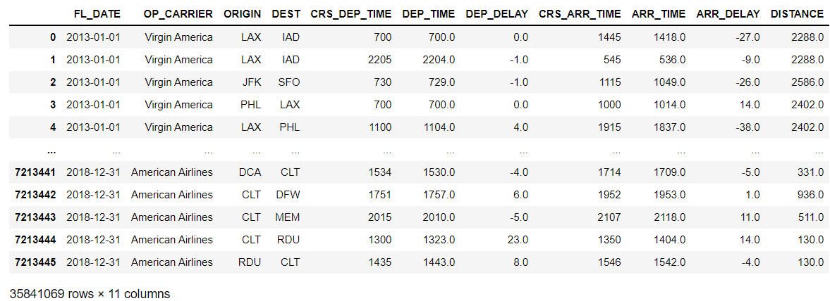
Our Data Frame

Slide 9
First Data Analysis
FL_DATE - Date of the flight
OP_CARRIER - Airline Identifier
ORIGIN - Departure Airport
DEST - Destination Airport
CRS_DEP_TIME - Planned Departure Time
DEP_TIME - Actual Departure Time
DEP_DELAY - Total Delay on Departure in minutes
ARR_DELAY - Total Delay on Arrival in minutes
If both of these numbers are negative =>> there was no delay (DEP_DELAY, ARR_DELAY)
If a number is positive = flight delayed

Slide 10
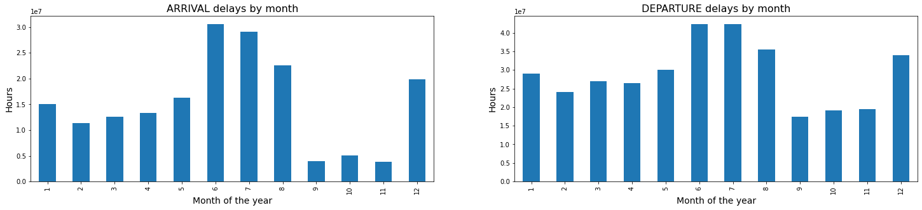
Data Visualisation
Arrival and departure delays by month of the year

Slide 11
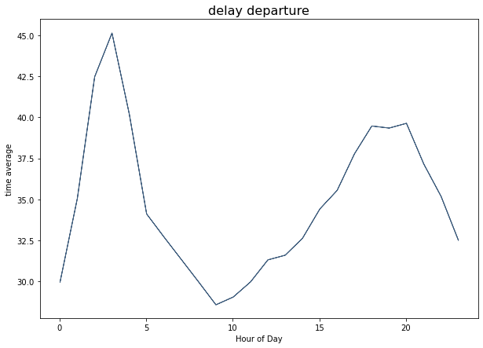
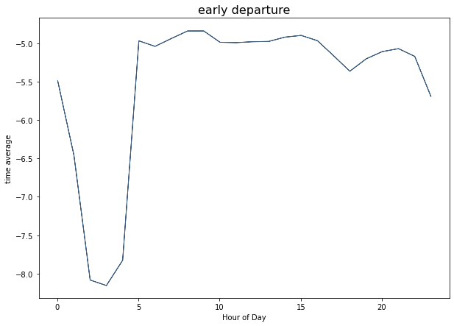
Delay Analysis

Slide 12
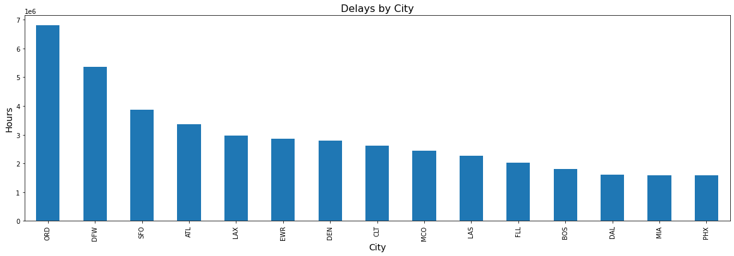
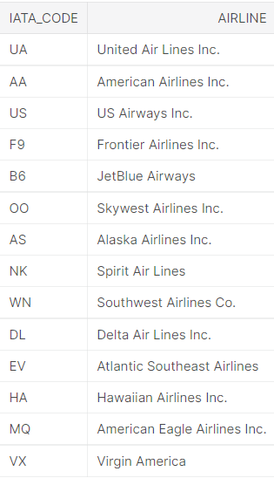
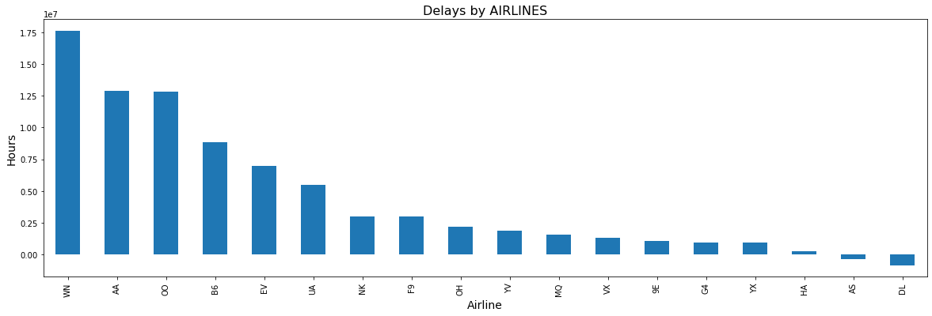
Delays by City
Delays by Airlines

Slide 13
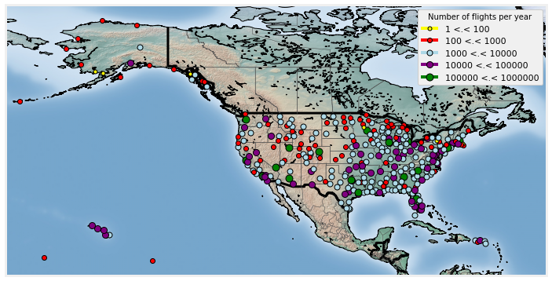
Airports Location

Slide 14
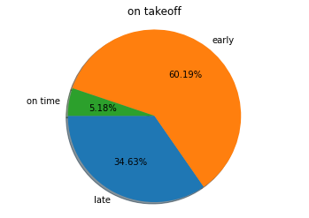
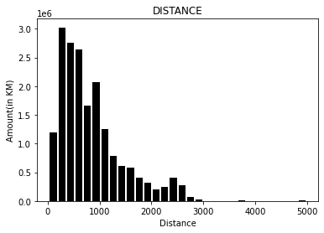
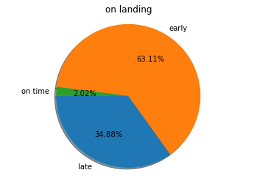
Analysis of distance and arrival times

Slide 15
Machine Learning
The primary goal of this project is to predict airline delays caused by various factors. Flight delays lead to negative impacts, mainly economical for commuters, airline industries and airport authorities. Furthermore, in the domain of sustainability, it can even cause environmental harm by the rise in fuel consumption and gas emissions.
Hence, these factors indicate how necessary and relevant it has become to predict the delays no matter the wide-range of airline meshes. To carry out the predictive analysis, which encompasses a range of statistical techniques from supervised machine learning and, data mining, that studies current and historical data to make predictions or just analyze about the future delays, with help of Regression Analysis.

Slide 16
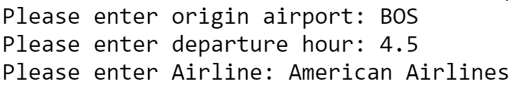
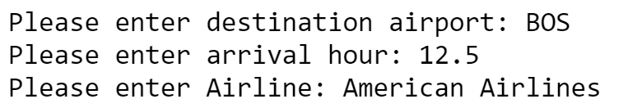
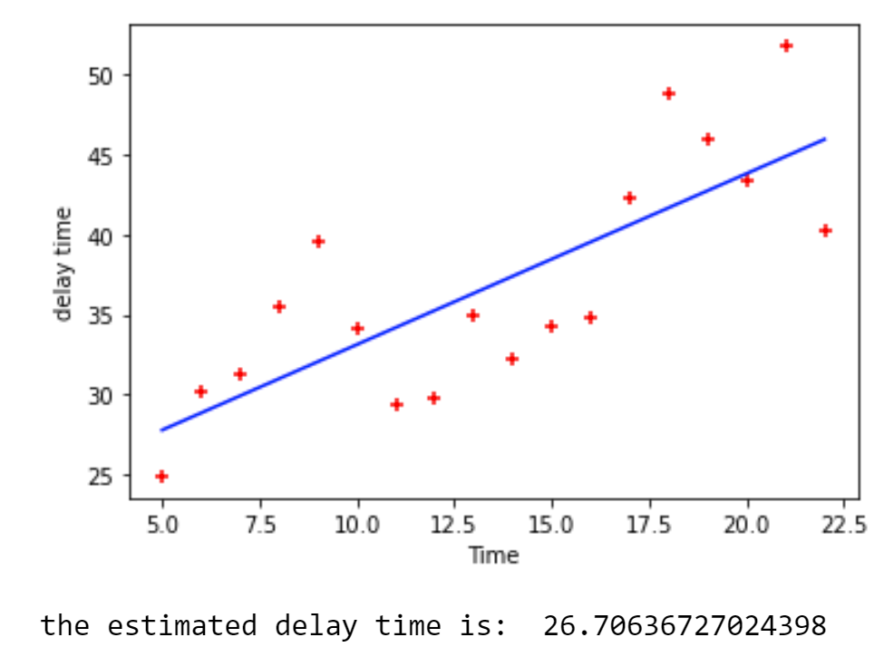
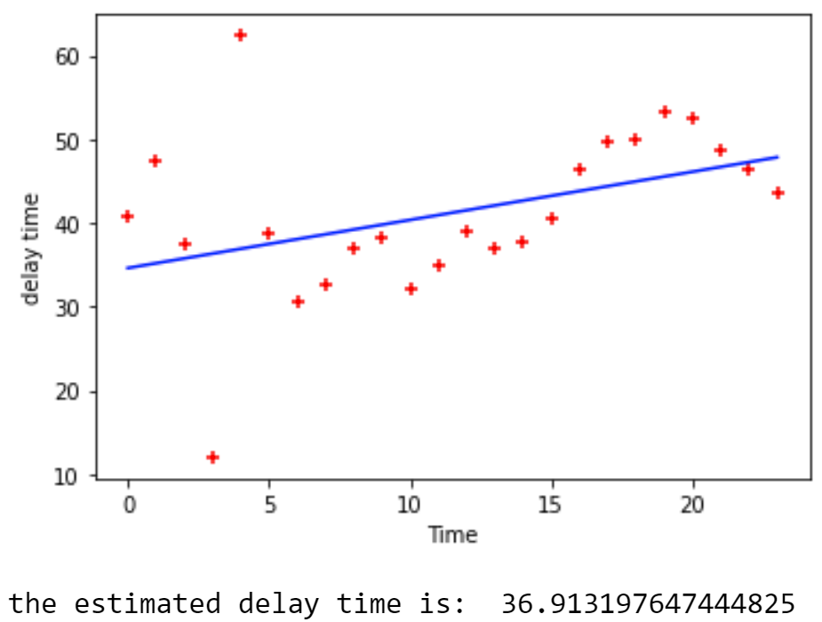
Linear Regression
Predict the estimate delay time on departure
Predict the estimate delay time on arrival

Slide 17

ML - Conclusions
Using “sklearn” library and linear regression we were able to train a model that predicts the flight delays.
Finally, we can make a conclusion from these observations that there is a high variability in average delays, both between the different airports but also between the different airlines. This is important because it implies that in order to accurately model the delays, it will be necessary to adopt a model that is specific to the company and the home airport.

Slide 18
link to GitHub

